Slide 1

DATA MINING (B9BA103) 2023-2024
CA1: Predictive Modeling and Cost Benefit Analysis for Type 2 Diabetes Using Classification Techniques
Presented by: Ariful Hasan (ID: 20024055), Royson Martis (ID: 20019263),
Sanil Ghag (20020146), Diti Modi (ID: 20028102),
Kashmira Ghag (20023193)

Slide 2

Introduction, Problem & Objective
Data Preparation &
Different Classification Techniques comparison
Building Confusing matrix
Cost Benefit Analysis
Reference & Bibliography

Slide 3

Introduction
CDC is the nation's leading science-based, data-driven, service organization that protects the public's health.
Dataset used for this assignment contains 253,680 responses to a telephone survey related to type 2 diabetes. This survey was conducted in 2015 by United States’ Centers for Disease Control & Prevention (CDC).
Diabetes is among the most prevalent chronic diseases in the United States, impacting millions of Americans each year and exerting a significant financial burden on the economy.

Slide 4
Problem & Objective
Problem
Type 2 diabetes affecting millions of health of Americans causing an enormous financial burden on the US economy indirectly increasing the medical costs and reduced productivity.
Objective
To facilitate early intervention and reduce prevalence of type 2 diabetes in the
country.
To create a robust predictive model that can predict type 2 diabetes in an individual.
To gain a better understanding of the most significant predictors of type 2 diabetes.

Slide 5
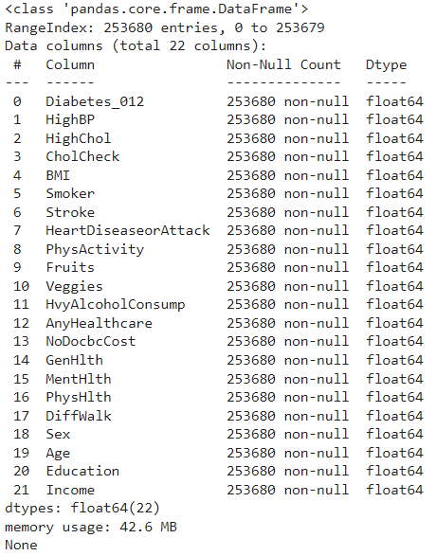
Data Preparation
Data Source: For building this model, we have used a dataset named diabetes _ 012 _ health _ indicators _ BRFSS2015.csv’ we from Kaggle (Link in Appendix section)
Target variable - In this dataset, we have considered Diabetes_012 as a target feature and also there are other 21 features given in the dataset (total 22 columns)
We have mapped target variables values in the following to classify into two (Due to three class in same target feature) :
dataset['Diabetes_012'] = dataset['Diabetes_012'].map({0:0, 1:0, 2:1})
[We considered No diabetes & Pre-diabetes with the same class 0 and the target class 2 with 1]
Missing Value- There are no missing values in the dataset.
Less Important Variables - Due to less important features, we have dropped AnyHealthcare, CholCheck, NoDocbcCos, Stroke, HvyAlcoholConsump.
Afterwards, we have divided dataset into feature and label, along with performing Scaling, splitting , balancing action

Slide 6
Classification Techniques
We have implemented the following five classification techniques in the data coding:
Logistic Regression(LR)
Logistic regression is a simple and more efficient method for binary and linear classification problems.
Adaboost Classifier
Adaboost is to set the weights of classifiers and training the data sample in each iteration such that it ensures the accurate predictions of unusual observations.
Random Forest Classifier
A random forest (RF) classifier is an ensemble classifier that produces multiple decision trees, using a randomly selected subset of training samples and variables.
SVM
Support vector machines (SVMs) are a set of supervised learning methods used for classification, regression and outliers detection.
Decision Tree Classifier: In order to produce judgements and predictions, the Decision Tree classifier is a supervised learning method that divides data into subsets according to the most important predictor factors.

Slide 7
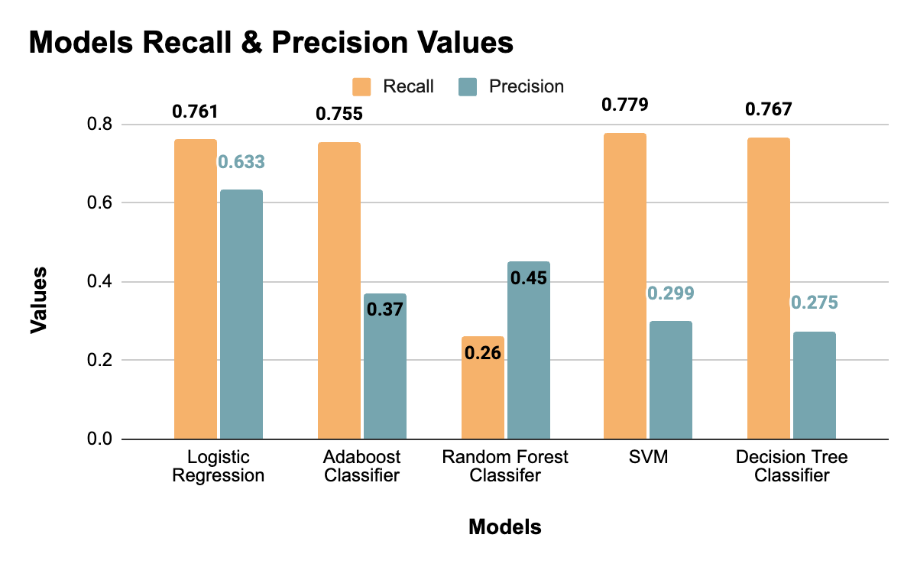
Comparison of different models
.

Slide 8
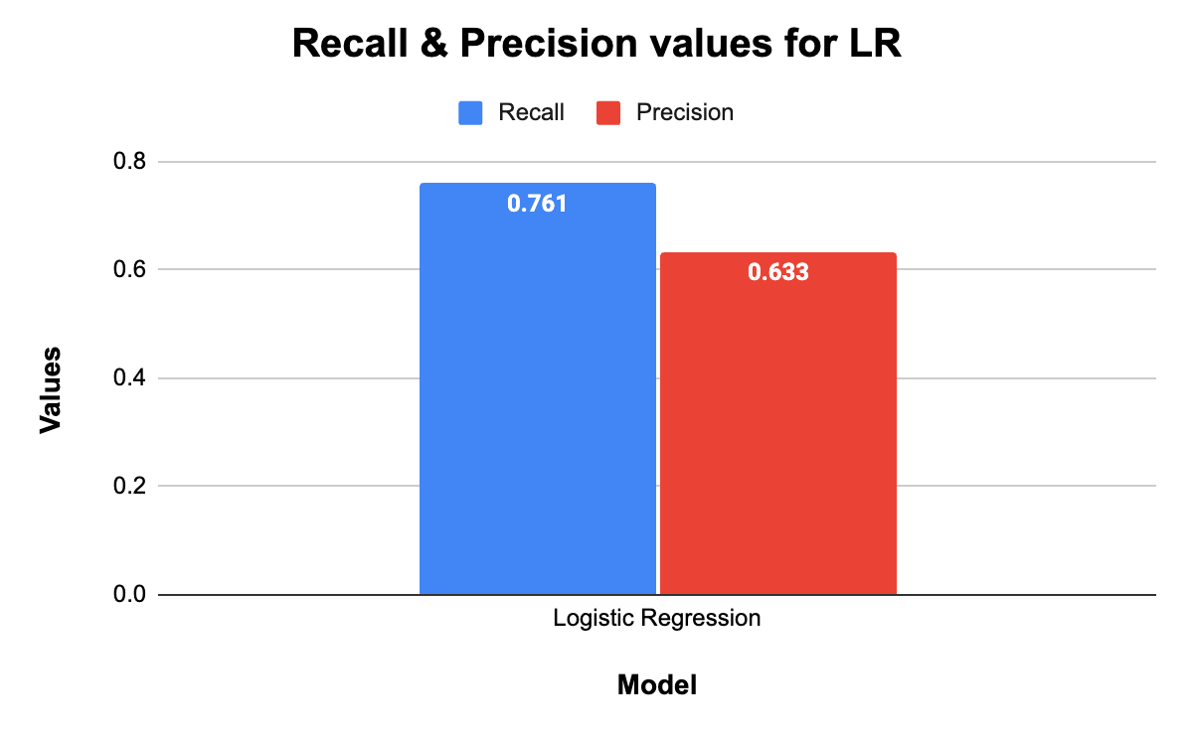
Best Model Training and Evaluation
Logistic Regression
Logistic regression showed the following metrics.
Recall - 0.761
Precision - 0.633
Our analysis indicates that Logistic Regression is the most effective model, providing excellent results in cost-benefit analysis.

Slide 9
Building Confusion Matrix
Let's define the terms:
True Positives (TP): Correctly predicted diabetes 2 cases.
False Positives (FP): Incorrectly predicted diabetes 2 cases (predicted as diabetic but not actually diabetic).
True Negatives (TN): Correctly predicted non-diabetes 0 and pre-diabetes 1 cases.
False Negatives (FN): Incorrectly predicted non-diabetes 0 & pre-diabetes 1 cases (predicted as non-diabetic & pre-diabetes cases but actually diabetes 2).
From the dataset:
Total actual diabetes 2 cases,
TP+FN = 35346 ..........................(1)
Total dataset size,
(TP+FP+TN+FN) = 253680..........(2)
Recall,
TP / (TP + FN) = 0.761.................(3)
Precision,
TP / (TP + FP) = 0.633 .................(4)

Slide 10
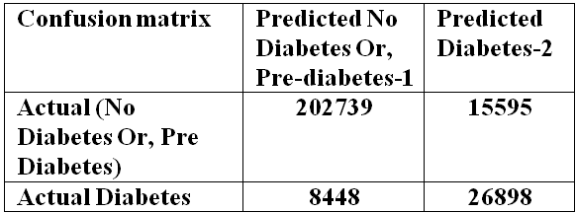
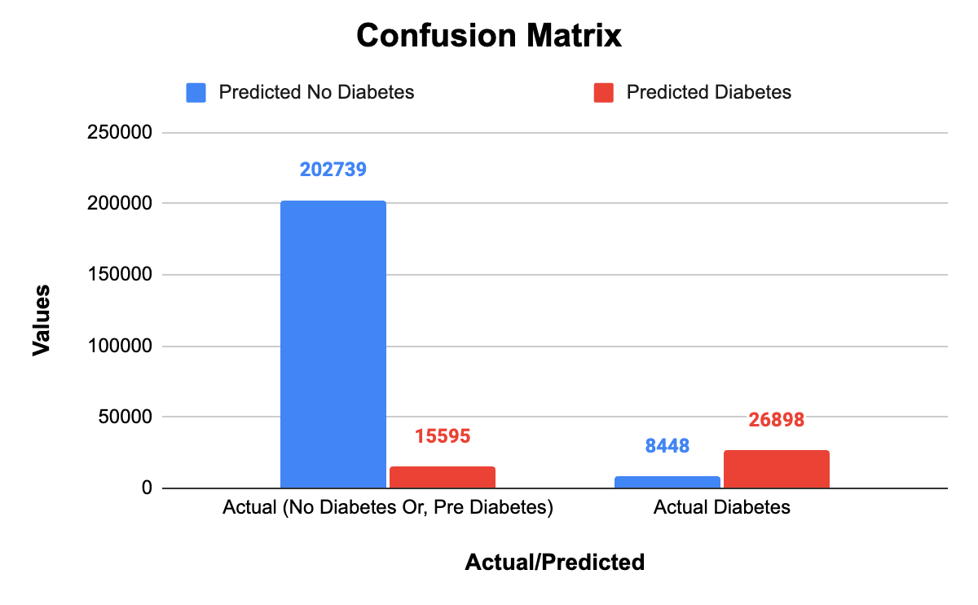
Confusion Matrix
Below we have shown the confusion matrix created for Logistic Regression,
This matrix indicates:
True Negatives (TN): 202739
False Negatives (FN): 8448
False Positives (FP): 15595
True Positives (TP): 26898

Slide 11
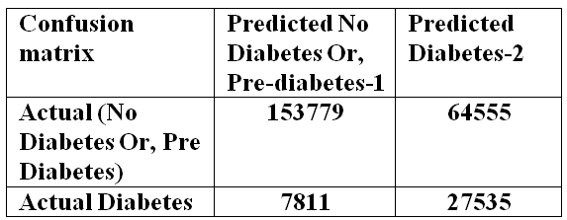
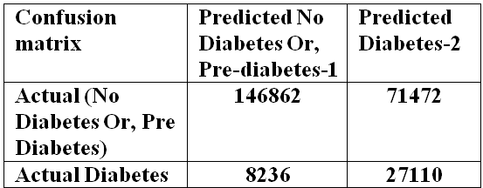
Confusion Matrix for others model
Below we have shown the confusion matrix created for SVM
Below we have shown the confusion matrix created for Decision Trees
This matrix indicates:
True Negatives (TN): 153779
False Negatives (FN): 7811
False Positives (FP): 64555
True Positives (TP): 27535
This matrix indicates:
True Negatives (TN): 146862
False Negatives (FN): 8236
False Positives (FP): 71472
True Positives (TP): 27110

Slide 12
Cost Benefit Analysis
Based on best Model LR:
For the annual cost of each patient info was collected from USA website given in the appendix.
Cost per Diabetes Patient: $16,752 per year as mentioned in website source
FP Cost: Costs related to unnecessary test, treatment, stress, and follow-up tests.
TP Savings: Savings from early intervention and preventing complications.

Slide 13
Cost Benefit Analysis
Based on best Model LR:
Total Costs without the Model
Current Annual Cost: $ 16752 * 35346
= approx. $592.02 million for diagnosed patients.
Cost with the Model
FP Costs: Let’s assume an additional cost of $1,000 per FP due to unnecessary treatments and follow-ups.
TP Savings: Assume savings of 20% per TP due to early intervention
($16752 * 20% = $3,350.40).

Slide 14
Cost Benefit Analysis
Based on best Model LR:
Benefit Analysis
Total Cost Savings: No. of TPs * Savings per TP = 26898×3350.40=$92303814
=$90.127 million
Total Additional Costs: No. of FPs * Additional cost per FP= 15595*1000
= 15.555 million
Net Benefit
Net Benefit = Total Cost Savings - Total Additional Costs = $90.127 million - 15.555 million
= approx. $74.532 million
Total Costs with the new Model : $592.02-$90.127+15.555
= $517.488 million

Slide 15
Cost Benefit Analysis Outcome
Based on best Model LR:
Total Annual Cost without the Model: approx. $592.02 million
Net Benefit of Implementing the Model: approx. $74.532 million
And then Total Annual Cost with the Model: approx. $517.488 million
So, if we implement the predictive model for type 2 diabetes, it will reduce the annual cost for diabetes from $592.02 million to $517.488 million, resulting in annual savings of $74.532 million.

Slide 16
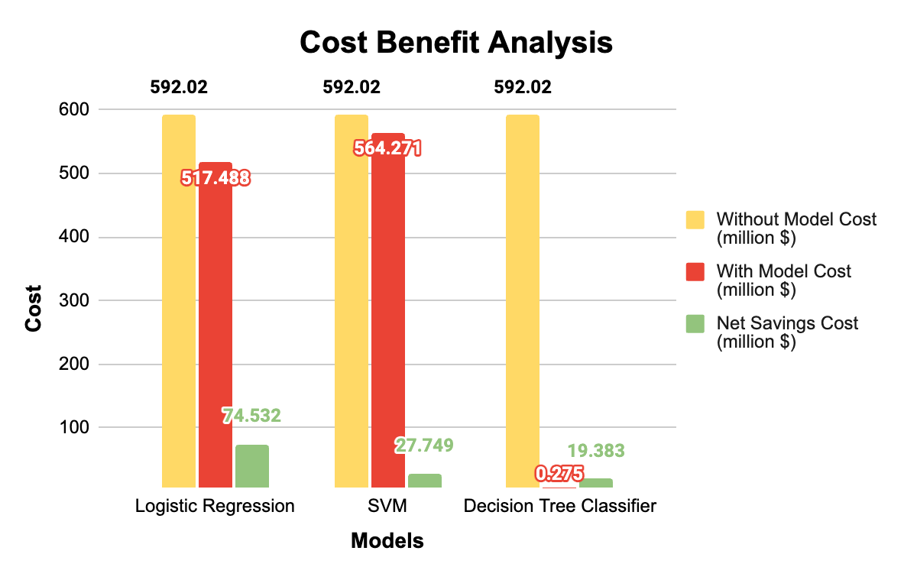
Models Cost Benefit Analysis: Comparison with different model
From the report below, Logistic Regression model has the highest Net saving cost value.

Slide 17
Recommendation
Performance Metrics:
In terms of recall, precision and cost benefit analysis, Logistic Regression outperformed other models. Cost-Benefit research: The research showed that the best net savings $74.532 million come from using Logistic Regression, which is important for real-world implementation in public health initiatives. Predictive Power: The model successfully detects those who are at risk of type 2 diabetes, allowing for early intervention and possibly lowering the disease's overall prevalence and financial burden. In light of these variables, our study's best-recommended model for predicting type 2 diabetes is logistic regression.

Slide 18
Reference & Bibliography
https://diabetesjournals.org/care/article/41/5/929/36592/The-Cost-of-Diabetes-Care-An-Elephant-in-the-Room
https://www.kaggle.com/datasets/alexteboul/diabetes-health-indicators-dataset

Slide 19


